Slide 1

Zero-Skipping Computation on Neural Networks (Week 12)
June 2, 2020
Sungjoo Yoo
Computing Memory Architecture Lab.
CSE, SNU
http://cmalab.snu.ac.kr

Slide 2
Weekly Schedule
W1 17 Application (deep learning on FPGA)/SW app (MNIST/CIFAR)
W2 25 Verilog 1 Basics/Vivado tutorial (verification level of HW design)
W3 31 Verilog 2 Combinational circuits (Video pre-view homework + TA Q&A)/Simple adder using dsp (V+V, Verilog intro)
W4 4/7 Verilog 3 Sequential circuits/V*V processing element (PE) design 1
W5 14 Verilog 4 Design example & synthesizable code/V*V processing element (PE) design 2
W6 21 Convolution lowering and matrix multiplication accelerator/Convolution lowering (V0)
W7 28 Intro to Zynq & MV accelerator design/Zynq FPGA & synthesis, continue VV design & start MV accelerator design
W8 5/5 (Children’s day) Optional lab session is provided in lecture and lab hour
W9 12 Main memory (physical & virtual)/OS+FPGA (HOST~DEVICE) communication & MV design 2
W10 19 Bus and DMA (Video pre-view + TA Q&A)/custom IP & MV design 3
W11 26 Advanced deep learning #1 quantization for low precision computation/V0+DMA+8b
W12 6/2 Advanced deep learning #2 optimization methods including zero skipping/layerwise acceleration
W13 9 Final exam/Project V0/1/2
W14 16 Optional practice sessions.& term project submission
Notes:
From this we will start to work on the baseline MV accelerator.

Slide 3
Agenda
Lecture: Zero-skipping computation on neural networks
Weight pruning
Convolution accelerator
Zero weight-skipping convolution accelerator
Zero activation-skipping MV accelerator
Introduction to the lab on Week 12
Layerwise acceleration

Slide 4

Zero Skipping in S10
Samsung developed a neural network accelerator which improves performance by skipping zero-input computation
There are two sources of zero values
Zero weights by pruning – Samsung NPU
Zero activations due to ReLU activation function – Our design example

Slide 5
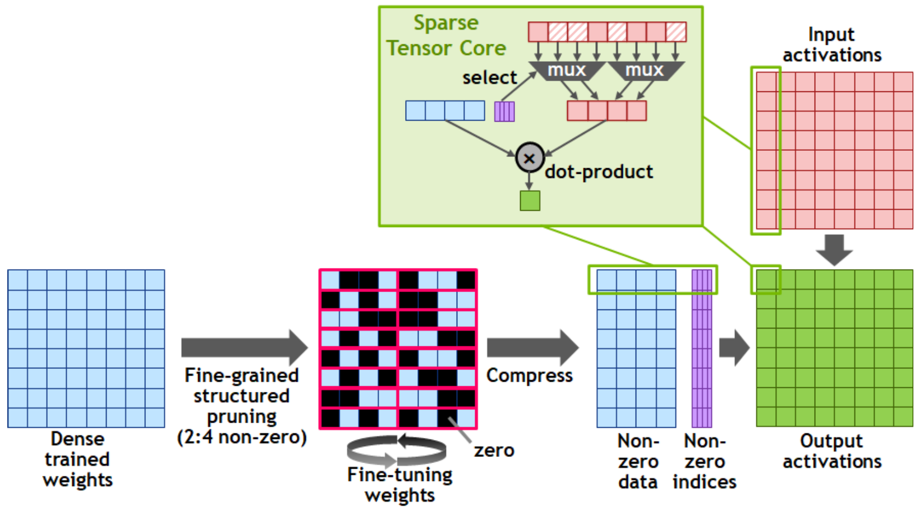
Zero Skipping in Nvidia A100
[https://www.nvidia.com/content/dam/en-zz/Solutions/Data-Center/nvidia-ampere-architecture-whitepaper.pdf]

Slide 6
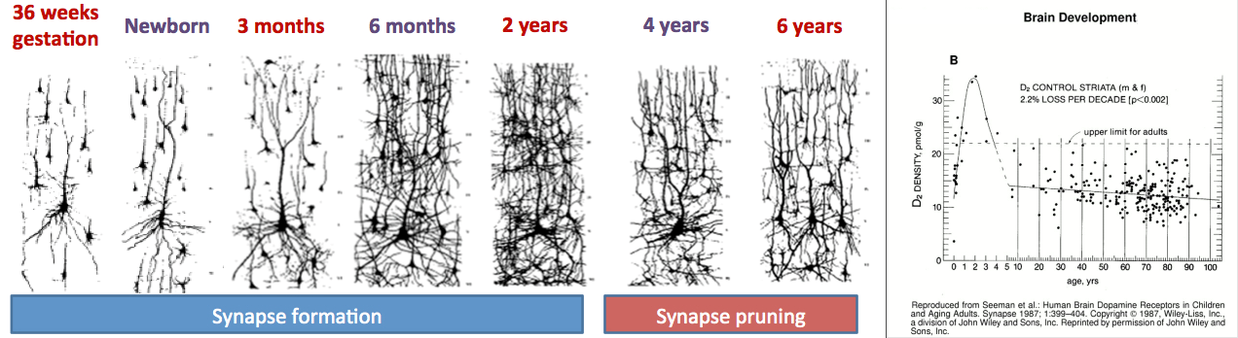
Neuron Pruning is Natural in Biological System
[https://universe-review.ca/R10-16-ANS12.htm]
# synapses increases before 2 years old and, then decreases due to pruning, possibly to reduce resource (e.g., energy) usage

Slide 7
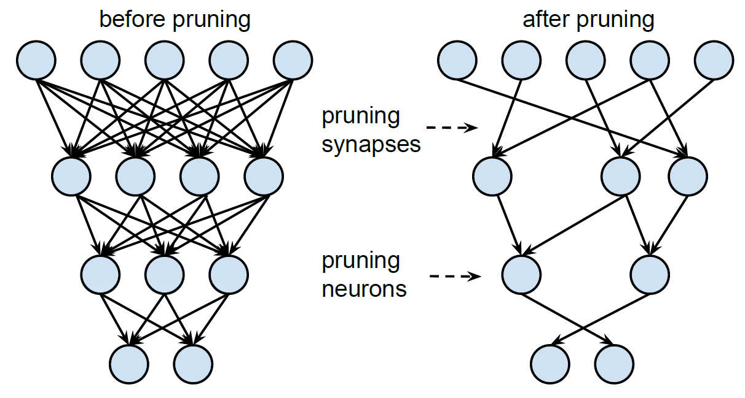
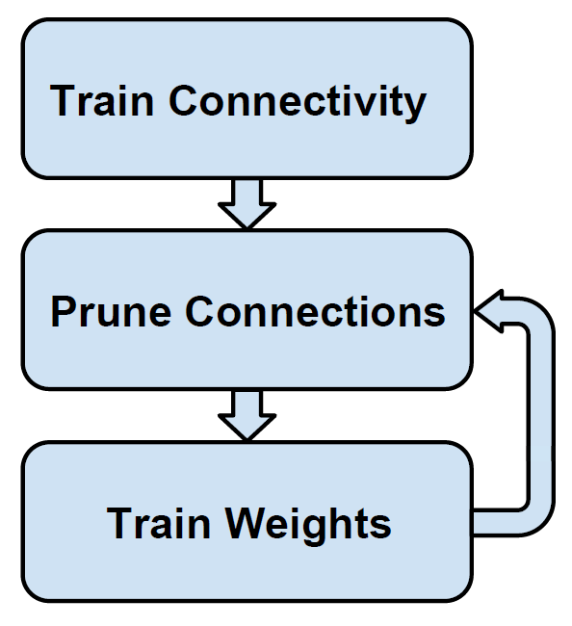
Pruning CNN: NIPS 2015
[Han, 2015]

Slide 8
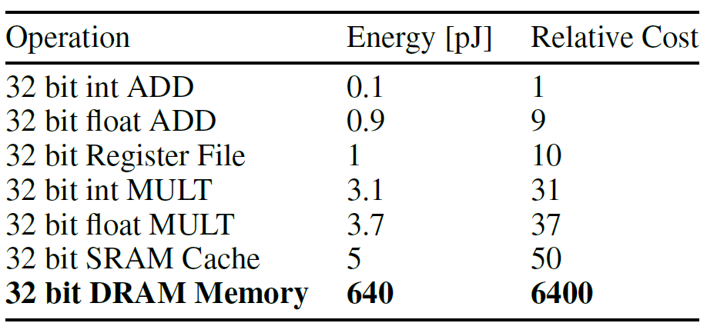
Goal and Benefits
“Our goal is to reduce the storage and energy required to run inference on such large networks so they can be deployed on mobile devices.”
Benefits of small models for mobile devices
Faster download
Lower energy consumption
“Energy consumption is dominated by memory access. Under 45nm CMOS technology, a 32 bit floating point add consumes 0:9pJ, a 32bit SRAM cache access takes 5pJ, while a 32bit DRAM memory access takes 640pJ, which is 3 orders of magnitude of an add operation. Large networks do not fit in on-chip storage and hence require the more costly DRAM accesses. Running a 1 billion connection neural network, for example, at 20fps would require (20Hz)(1G)(640pJ) = 12:8W just for DRAM access - well beyond the power envelope of a typical mobile device.”

Slide 9
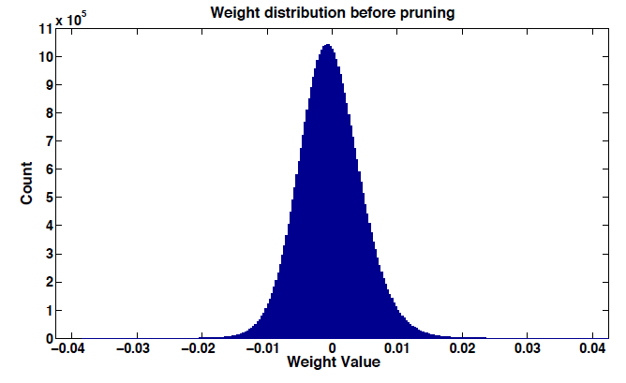
Illustration of Pruning
Weight distribution before pruning

Slide 10
Illustration of Pruning
Small weights are pruned, i.e., set to zero
Pruning small weights

Slide 11
Illustration of Pruning
During training, weights are re-distributed
Pruning small weights
During retraining,
weights tend to diverge

Slide 12
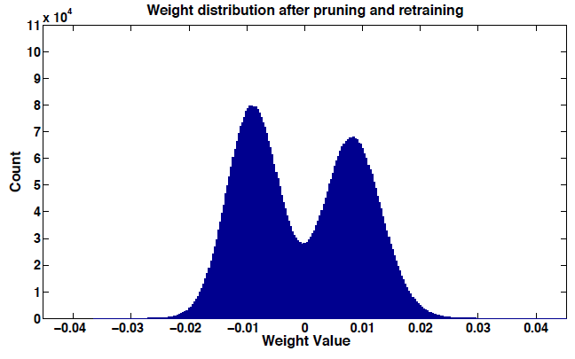
Illustration of Pruning
After a step of training, new small weights are obtained
Pruning small weights again
10X smaller scale

Slide 13
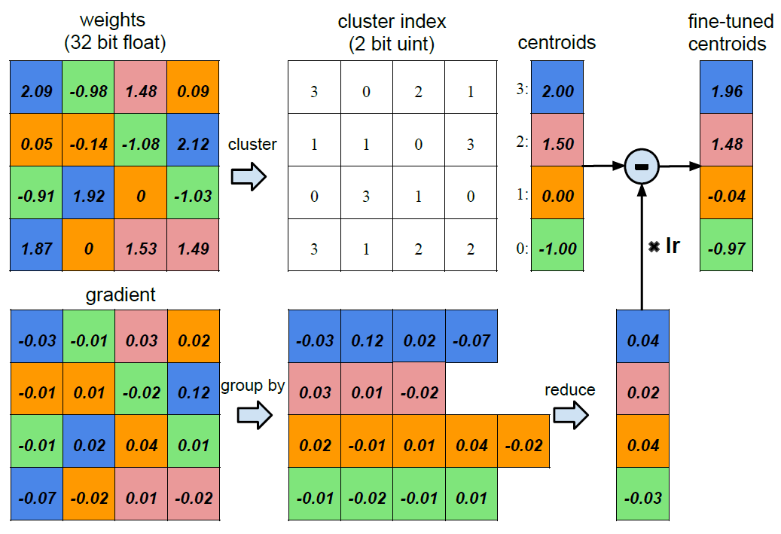
Weight Clustering to Reduce # Bits to Represent Each Weight
“We limit the number of effective weights we need to store by having multiple connections share the same weight, and then fine-tune those shared weights.”
“The weights are quantized to 4 bins (denoted with 4 colors), all the weights in the same bin share the same value, thus for each weight, we then need to store only a small index into a table of shared weights. During update, all the gradients are grouped by the color and summed together, multiplied by the learning rate and subtracted from the shared centroids from last iteration. For pruned AlexNet, we are able to quantize to 8-bits (256 shared weights) for each CONV layers, and 5-bits (32 shared weights) for each FC layer without any loss of accuracy.”

Slide 14
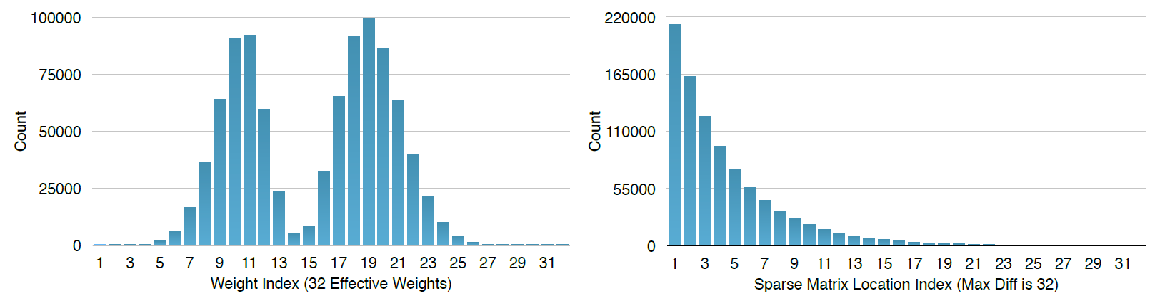
Huffman Coding
Applied to the indices of weight value tables in CSC format
Huffman coding allows frequent indices to be represented with less # bits

Slide 15
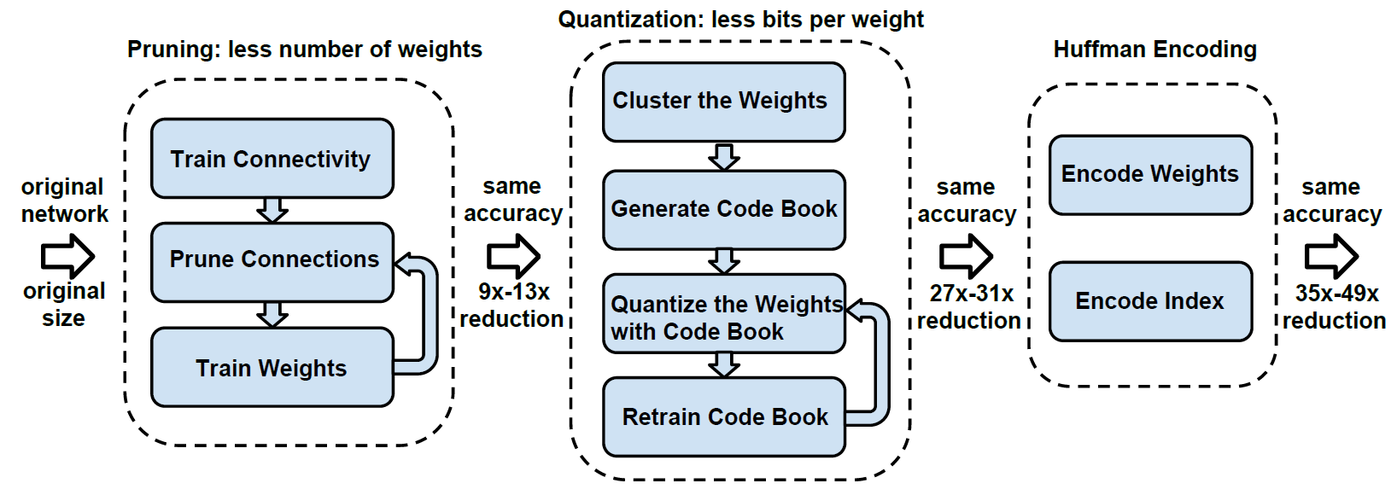
Pruning, Quantization and Compression: ICLR 2016

Slide 16
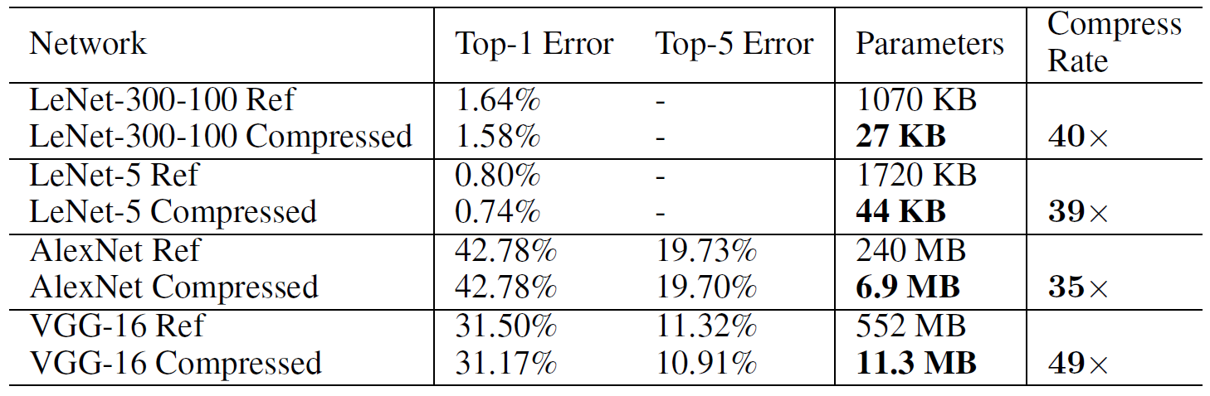
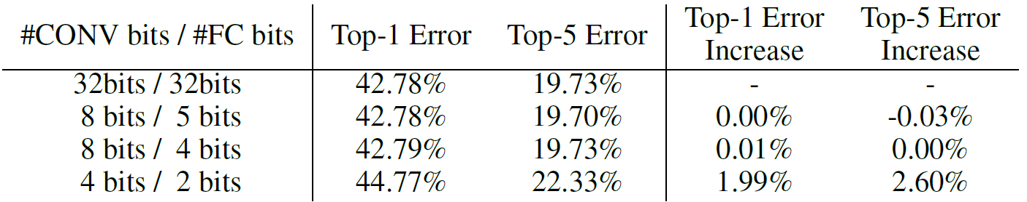
Significant Reduction in Model Size (# Weights) without Accuracy Loss
AlexNet

Slide 17
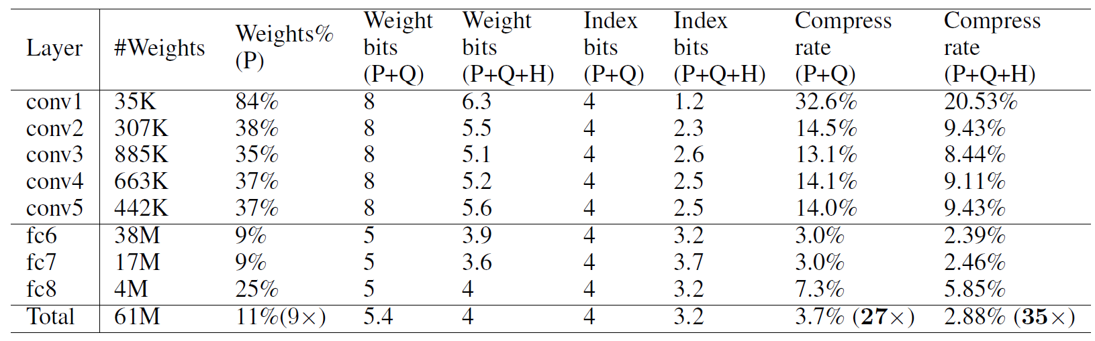
AlexNet: Per-Layer Compression Results
8b/5b case: 256 levels for CONV and 32 levels for FC layers
Finally, weights can be represented by ~2.5 bits (CONV) and ~3.5 bits (FC)

Slide 18
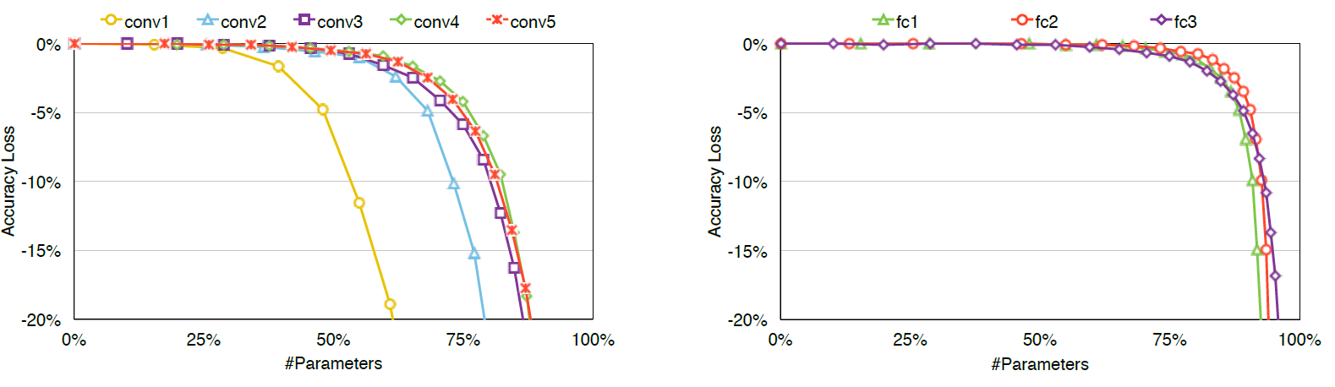
Per-Layer Sensitivity
CONV1 (near the input) is the most sensitive
FC layers (near the output) is much less sensitive

Slide 19
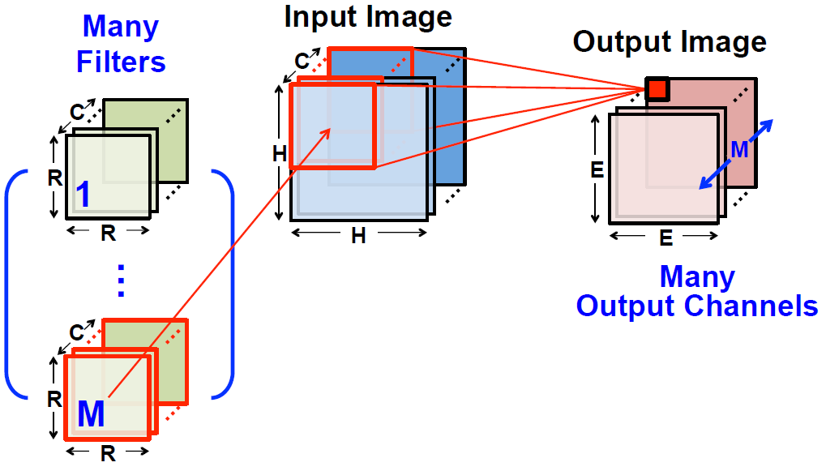
Convolution: 3D Input / 3D Output
[Chen, 2016]
Training (backprop) determines kernel weights

Slide 20
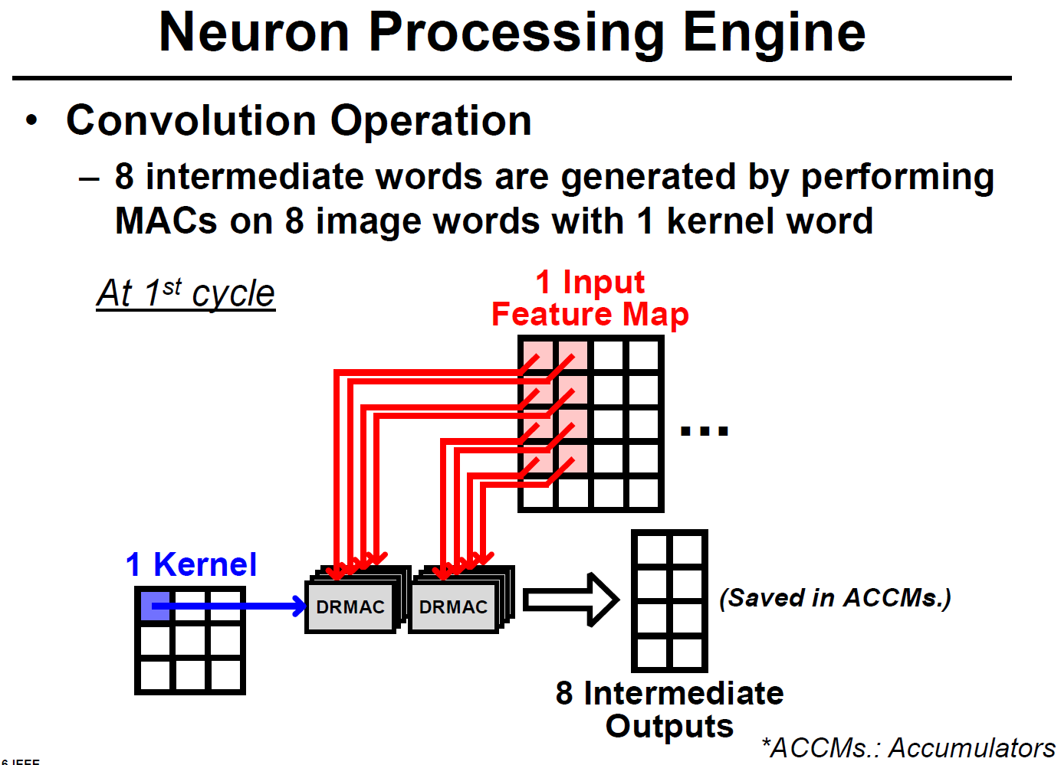
[KAIST]
Kernel weight is reused 8 times

Slide 21
[KAIST]
Kernel weight is reused 8 times

Slide 22
[KAIST]
Kernel weight is reused 8 times

Slide 23
[KAIST]
Kernel weight is reused 8 times

Slide 24
[KAIST]
Kernel weight is reused 8 times

Slide 25
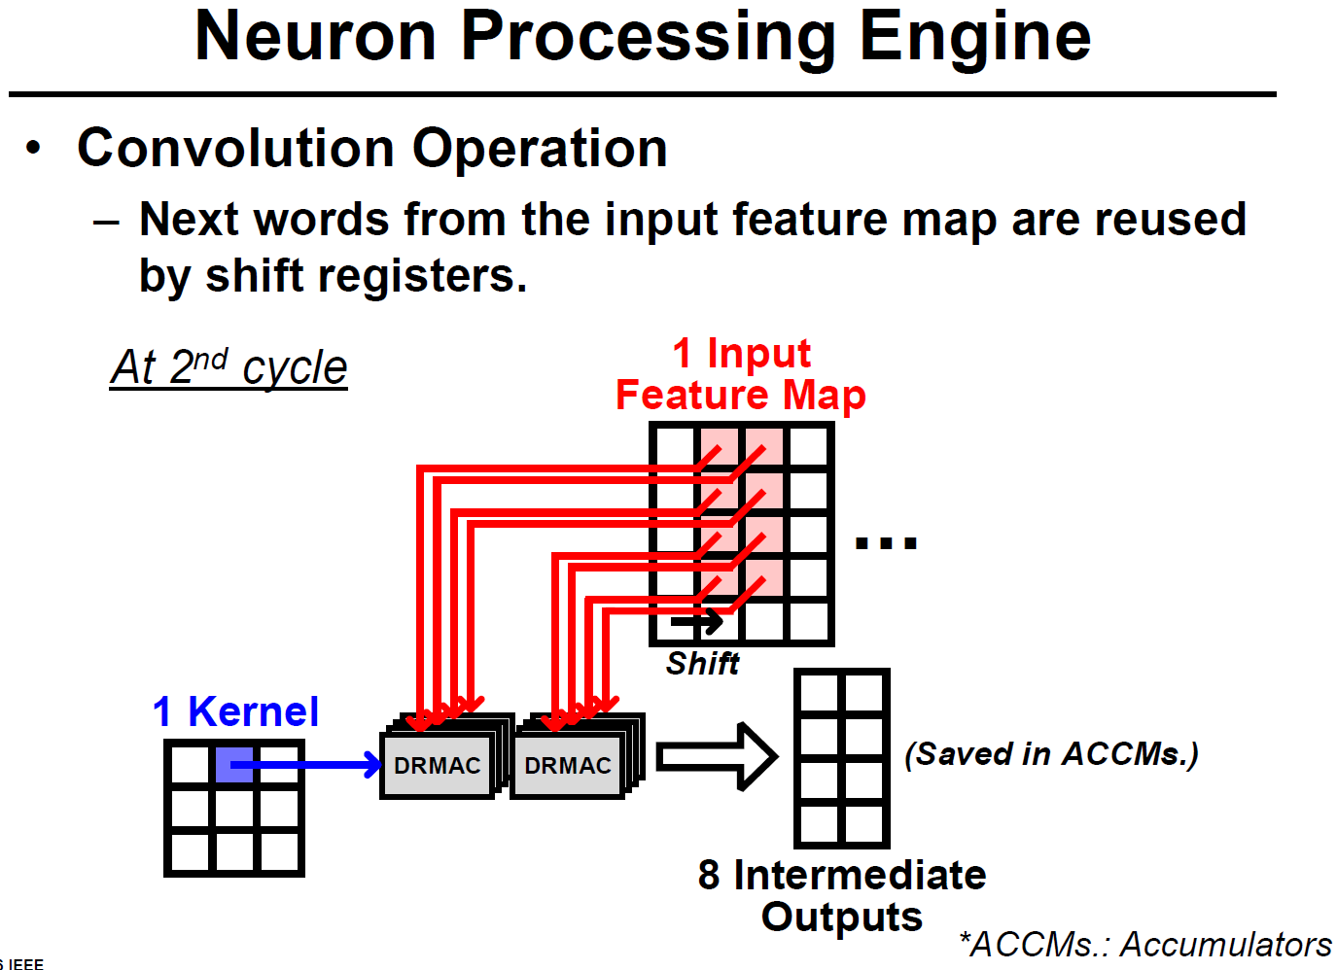
[KAIST]

Slide 26
[KAIST]

Slide 27
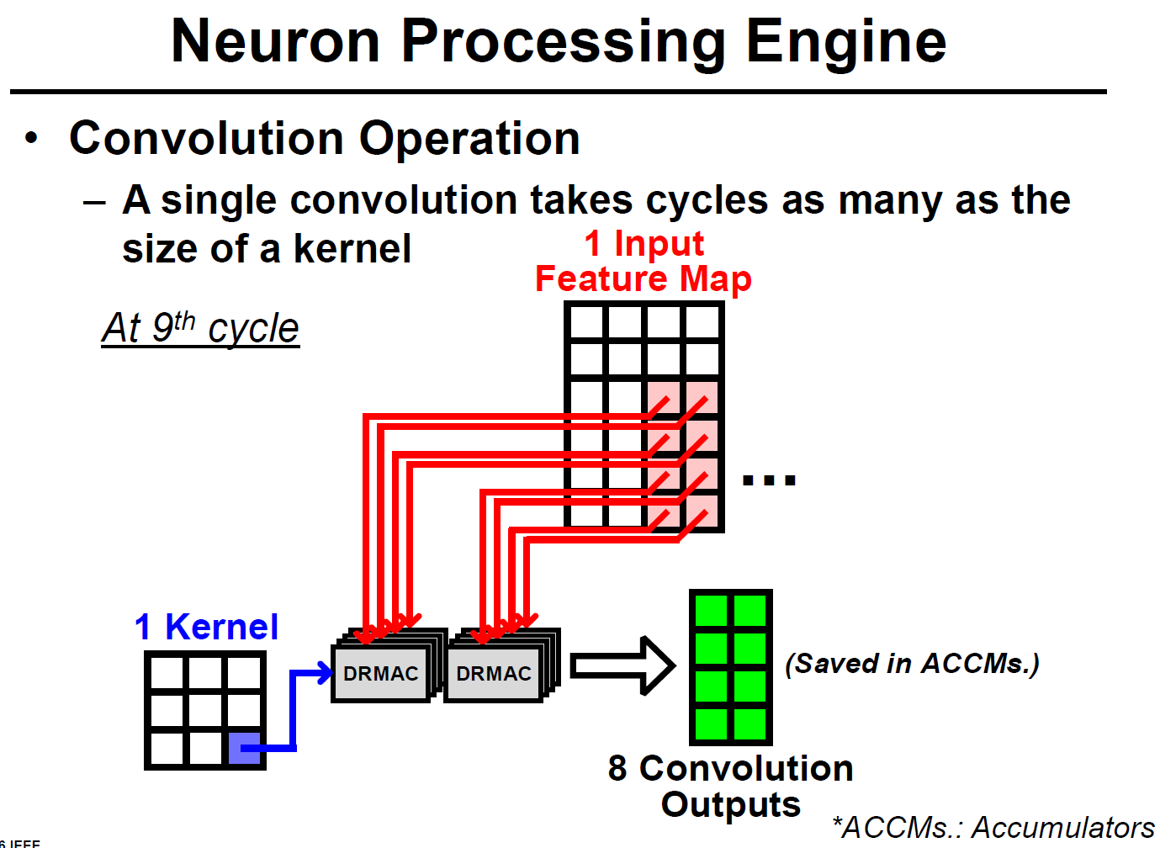
[KAIST]

Slide 28
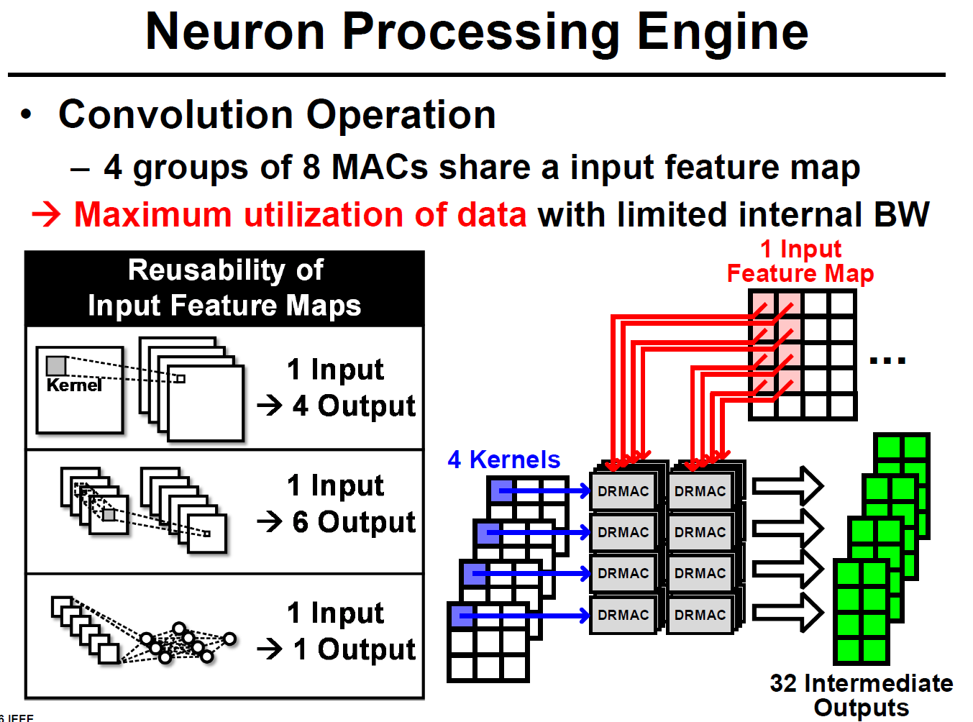
[KAIST]
Kernel weight is reused 8 times
Data item is reused 4 times

Slide 29
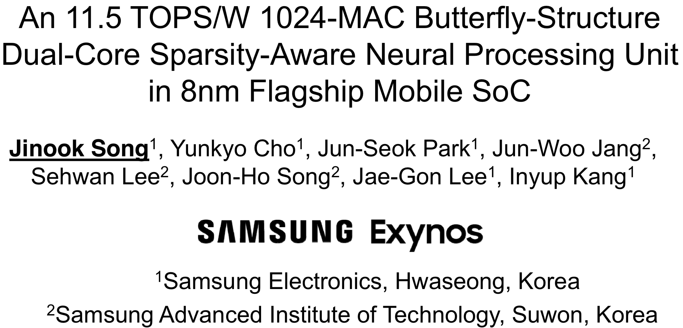
Zero Weight Skipping Accelerator
[ISSCC 2019]

Slide 30
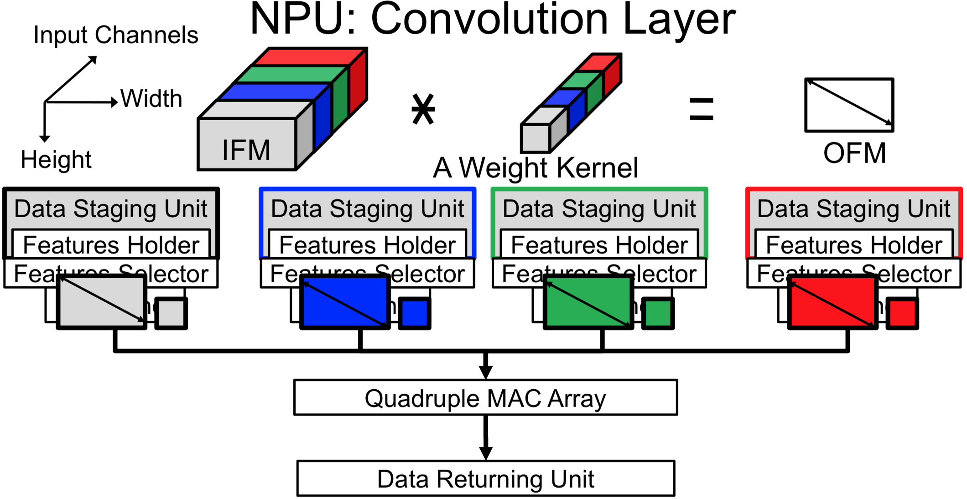

Slide 31
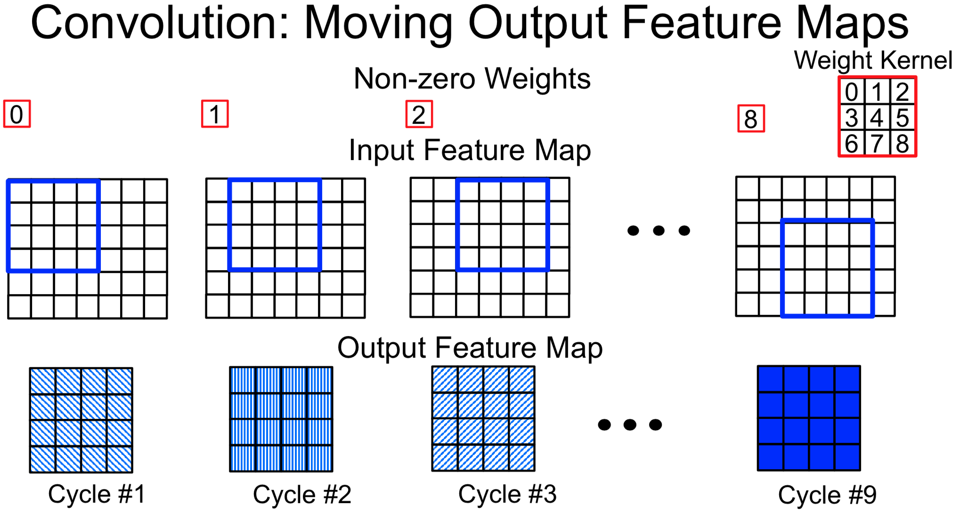

Slide 32
[KAIST]

Slide 33
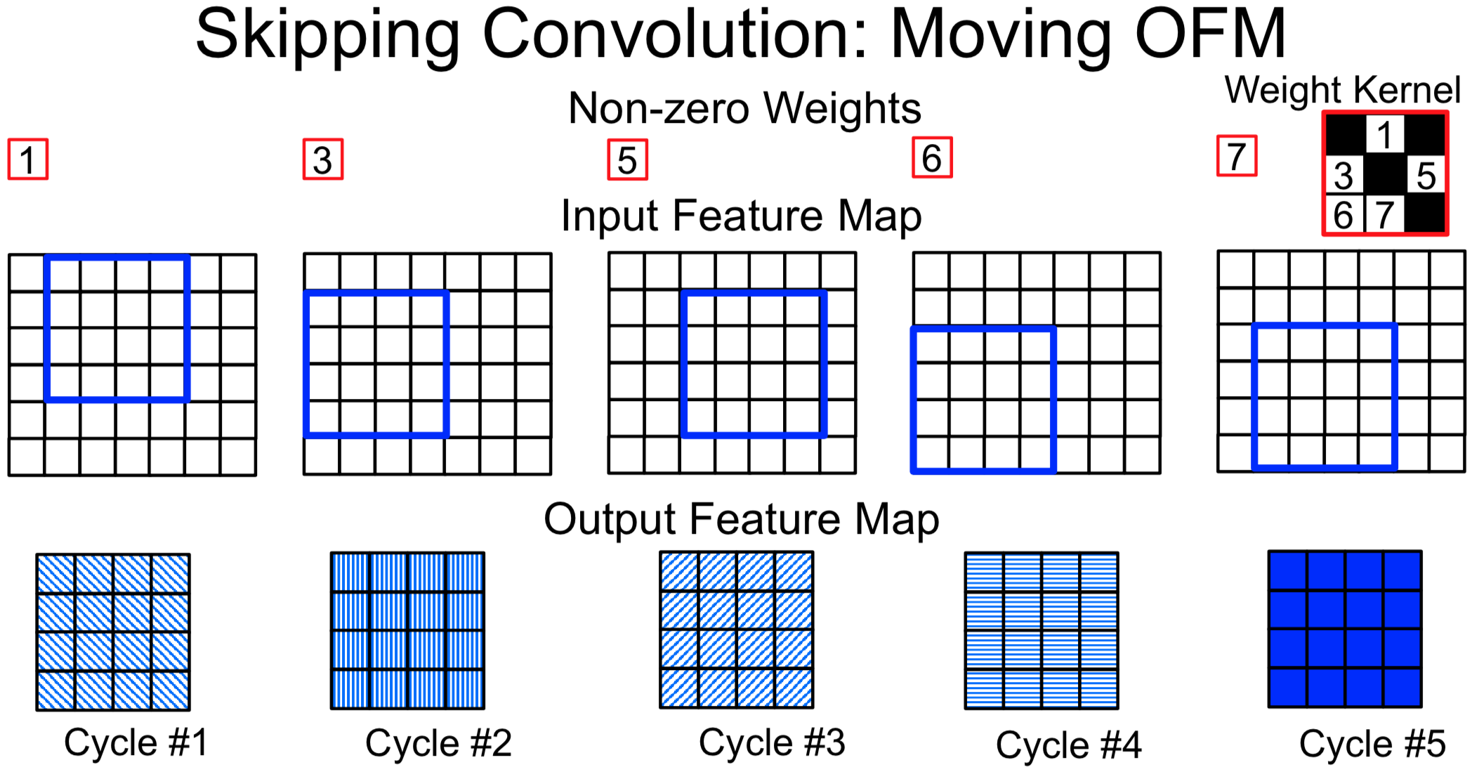

Slide 34
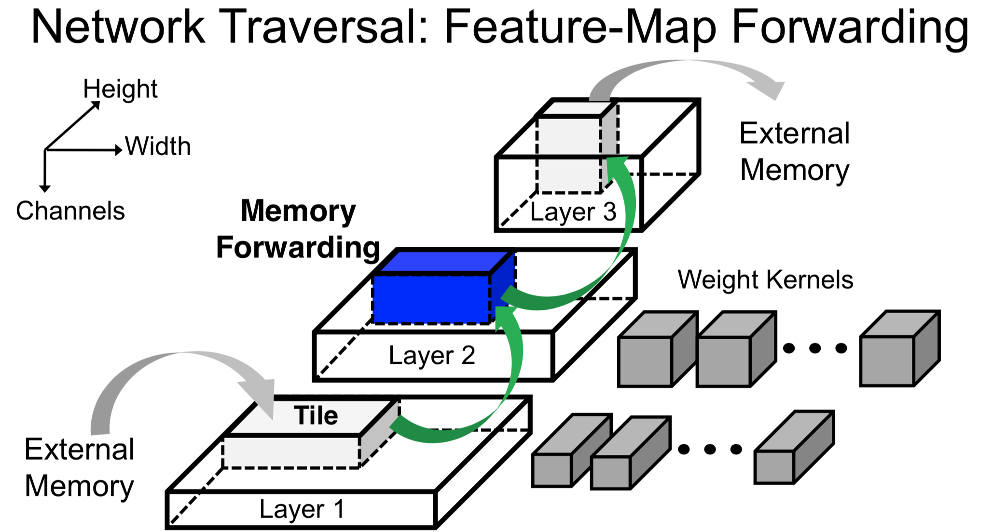

Slide 35
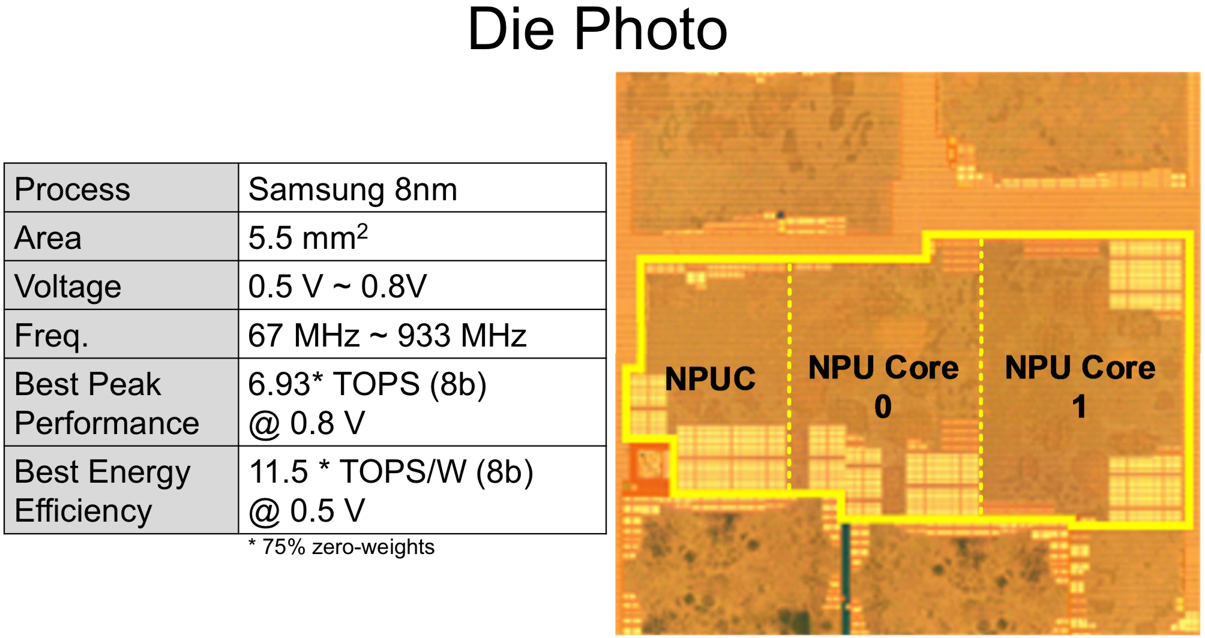

Slide 36
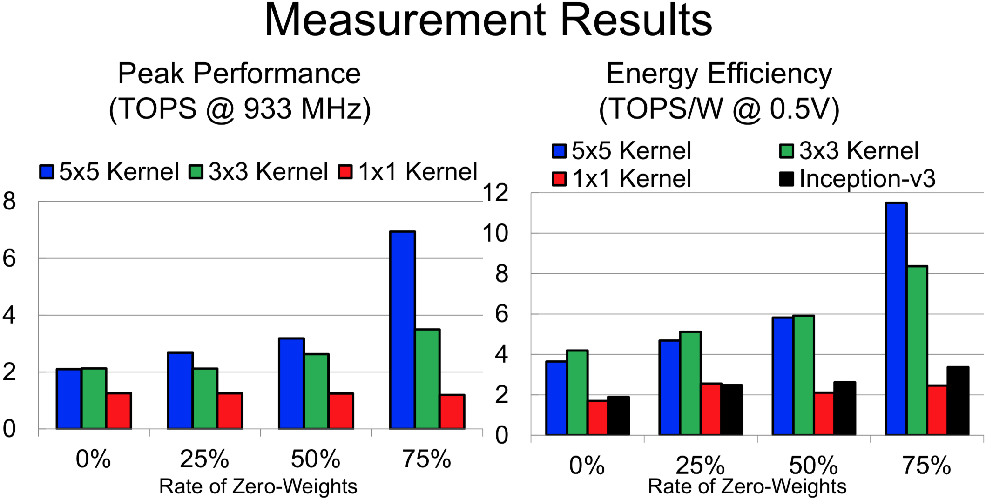

Slide 37
Zero Skipping in Nvidia A100
[https://www.nvidia.com/content/dam/en-zz/Solutions/Data-Center/nvidia-ampere-architecture-whitepaper.pdf]

Slide 38
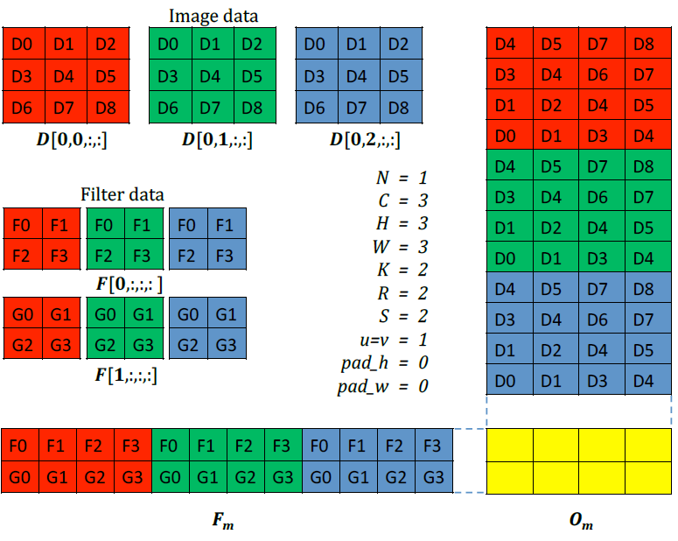
A Systematic Pruning Method: Overview of Group-wise Brain Damage
[Lebedev, 2016]
For each input feature map, the same location of 2D filter elements is pruned
Pruning is performed in an incremental manner
Repeat pruning a column and retraining as far as accuracy constraint is met
“convolutions can be reduced to multiplications of thinned dense matrices, which leads to speedup.”
3X reduction in # multiplications for AlexNet

Slide 39
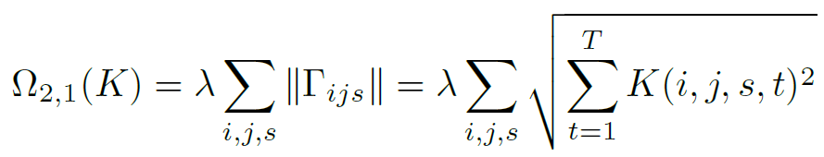
Regularizer for Structured Pruning
[Lebedev, 2016]
Sum of squared weights in a column of weight matrix
i,j: spatial dimension
s: input feature map
t: output feature map

Slide 40
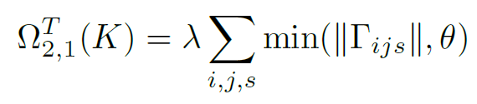
Truncated Regularizer
[Lebedev, 2016]
Regularizer represents only those columns having small weights
Columns having large weights are not included in the regularizer
Threshold θ controls pruning level
Training
Given δ (allowed accuracy loss),
E.g., 1% of top-1 accuracy
After each epoch
If additional error < δ, increase θ
Else, decrease θ
If |Γ|<ε, it is fixed to zero ← pruning

Slide 41
Zero-Input Activation Skipping Matrix-Vector Accelerator
skip
skip
X0XX0X0X
X0XX0X0X
Act
Vec
PE0
Weight
PE0
Matrix
X0XX0XX
0X00X0X
X0XX0XX
0X00X0X
PE1
PE1
Baseline Accelerator
computes multiple row*vector multiplications in parallel
Zero-skip Accelerator
reduces runtime by skipping zero-input multiplications

Slide 42
MV Accelerator
Matrix M (N x N)
Input vector V
Result R
MV accelerator
TxT tile
Memory (BRAM)
w11
w12
v1
r1
w21
w22
v2
r1
r2
r2
C cycles
v1
v2
CPU
w11
w12
X
=
w21
w22
1
1
1
Buffer1
MAC1
Register
w11
w12
X
p1
w21
w22
X
p2
Buffer2
MAC2
Tile 1
Tile 2
Tile N/T
C cycles
T
T
Time
Total execution cycles of MV = ((N/T)*(C+T+T))*(N/T)

Slide 43
MV Accelerator
Matrix M (N x N)
Input vector V
Result R
MV accelerator
TxT tile
Memory (BRAM)
w11
w12
v1
r1
w21
w22
v2
r1
r2
r2
C cycles
v1
v2
CPU
w11
w12
X
=
w21
w22
v1
1
1
Buffer1
MAC1
Register
w11
w12
X
p1
w21
w22
X
p2
Buffer2
MAC2
Tile 1
Tile 2
Tile N/T
C cycles
T
T
Time
Total execution cycles of MV = ((N/T)*(C+T+T))*(N/T)

Slide 44
MV Accelerator
Matrix M (N x N)
Input vector V
Result R
MV accelerator
TxT tile
Memory (BRAM)
w11
w12
v1
r1
w21
w22
v2
r1
r2
r2
C cycles
v1
v2
CPU
w11
w12
X
=
w21
w22
v2
1
1
Buffer1
MAC1
Register
w11
w12
X
p1
w21
w22
X
p2
Buffer2
MAC2
Tile 1
Tile 2
Tile N/T
C cycles
T
T
Time
Total execution cycles of MV = ((N/T)*(C+T+T))*(N/T)

Slide 45
Zero-Skipping MV Accelerator
Matrix M (N x N)
Input vector V
Result R
MV accelerator
TxT tile
Memory (BRAM)
w11
w12
v1
r1
w21
w22
0
r1
r2
r2
C cycles
v1
0
CPU
w11
w12
X
=
w21
w22
v1
1
1
Buffer1
MAC1
Register
w11
w12
X
p1
w21
w22
X
p2
Buffer2
MAC2
Tile 1
Tile 2
Tile N/T
C cycles
T
T
Time
Total execution cycles of MV = ((N/T)*(C+T+T’))*(N/T)

Slide 46
Agenda
Lecture: Zero-skipping computation on neural networks
Weight pruning
Convolution accelerator
Zero weight-skipping convolution accelerator
Zero activation-skipping MV accelerator
Introduction to the lab on Week 12
Layerwise acceleration

